Slide 1

SHEMA
Educational travelling game

Slide 2
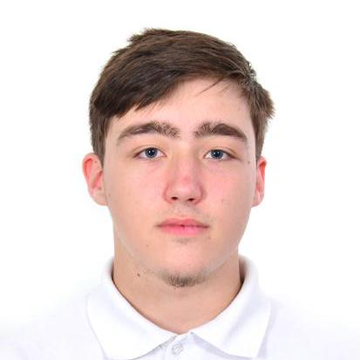
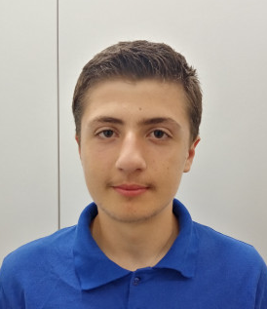
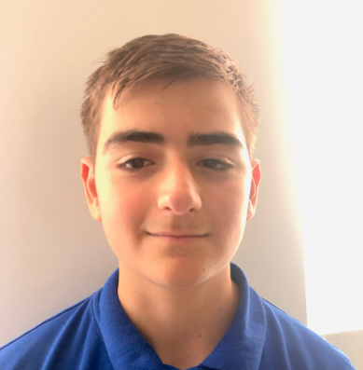
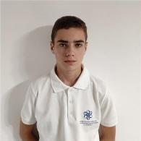
OUR TEAM
Maxim Marinov
Scrum Trainer
Emil Bogdanov
Back-end
Day 3
Stefan Hristov
Back-end
Hakan Chandar
QA Engineer

Slide 3
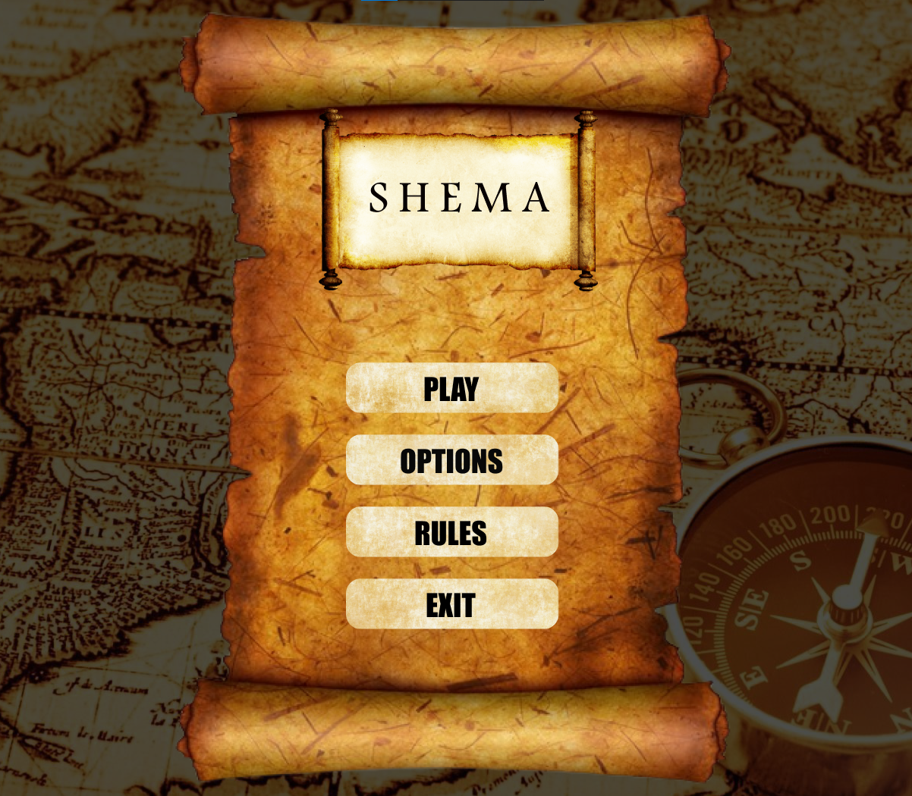
OUR IDEA
We had a total of 34 days to build this project from scratch. The idea was to make a main European travel game with the aim of getting to know Europe better.

Slide 4
STAGES OF DEVELOPMENT
1.
3.
2.

Slide 5












USED PROGRAMS

Slide 6
LET’S JUMP TO THE PROJECT!

